Slide 1

WEB Development
Grade 7&8

Slide 2
Recap of the last Class
Notes:
Objective:
Keep a healthy Discussion.
We learned how to create a navigation bar
Learned how to add a video and backdrop
Learned how to create a amazing looking hero section

Slide 3
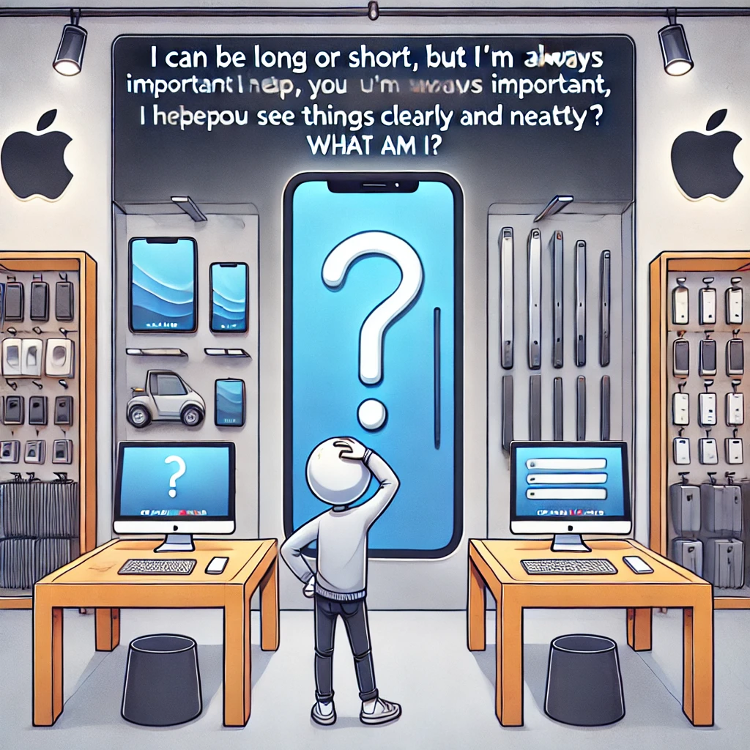
The Apple Store Riddle
Story: The Apple Store is launching a special event, but something is wrong with the product displays. One of the products refuses to show up, and instead, a mysterious message appears on the screen:
"I can be long or short, but I’m always important. I help you see things clearly and neatly. What am I?"
Can you solve this riddle and fix the display?
Notes:
Answer: A line of code (or CSS rule)!

Slide 4
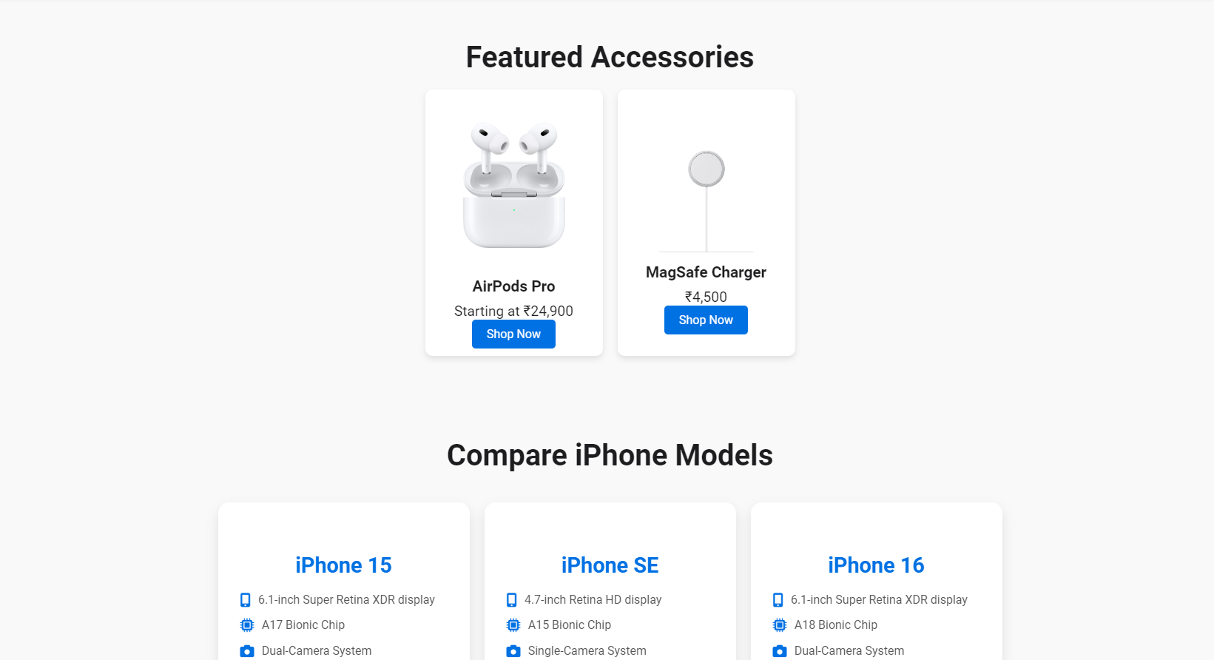
create a real-world online marketplace website
Notes:
Objective:
Create a engaging Product and Accessories Section
Day 2: Objective
Objective:
Implement the product & accessories section
Learn how to style a modern looking product & accessories section

Slide 5
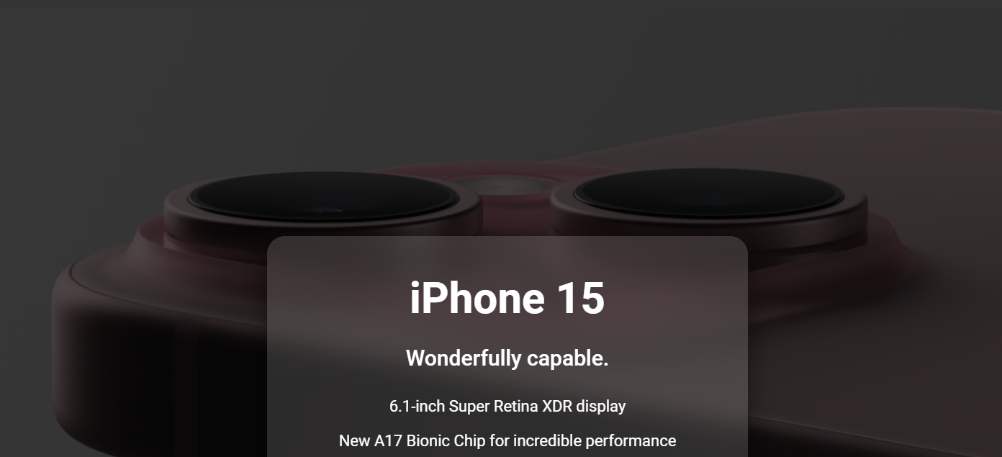
Project: Apple Clone
Notes:
Choose Level of Project Based on Student Capacity
Project Demo Link:
Basic Project Demo
Advance Project Demo
Project Code:
Basic: Apple Clone
Advance: Apple Clone
Objective:
Present the final project example.
Teacher Instructions:
Show the Screenshot:
Display the screenshot of the final project example.
Show the Project in Live Action:
Demonstrate the project on a live website to show how it functions.
Explain the Project:
Inform students that they will create a similar project.
Highlight the key features:
A responsive and user-friendly Webpage.
An engaging Hero Section.

Slide 6
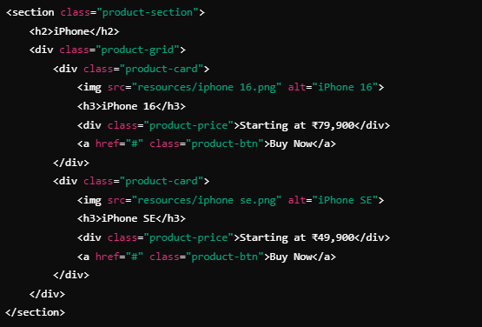
HTML Structure (Product Section)
Notes:
"Teacher's Activity"
Project Codebase:
Basic: Apple Clone
Advance: Apple Clone
Objective:
Understand how to create a basic html layout for a product card section
**** Use Tr code's for recap for better explanation and for code completion use code base. ****
Teacher Instructions:
Learn about how to use div and classes to separate code
Provide an overview of the section:
Code Explanation:
Two products (iPhone 16 and iPhone SE) are displayed, each inside a card with an image, title, price, and a purchase button.

Slide 7
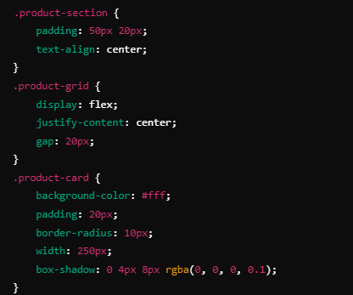
CSS (Product Section)
Notes:
"Teacher's Activity"
Project Codebase:
Basic: Apple Clone
Advance: Apple Clone
Objective:
Understand how to style the Product Section understand about flex box and Content alignment
**** Use Tr code's for recap for better explanation and for code completion use code base. ****
Teacher Instructions:
Display the screenshot of the CSS code.
Provide an overview of the section:
Code Explanation:
flex is used to display product cards side by side, with spacing managed by gap.
Each card has a white background, a box shadow for depth, and rounded corners.

Slide 8
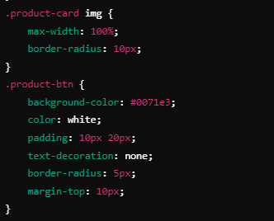
CSS (Product Section)
Notes:
"Teacher's Activity"
Project Codebase:
Basic: Apple Clone
Advance: Apple Clone
Objective:
Understand how to style the Product Section understand about flex box and Content alignment
**** Use Tr code's for recap for better explanation and for code completion use code base. ****
Teacher Instructions:
Display the screenshot of the CSS code.
Provide an overview of the section:
Code Explanation:
flex is used to display product cards side by side, with spacing managed by gap.
Each card has a white background, a box shadow for depth, and rounded corners.

Slide 9
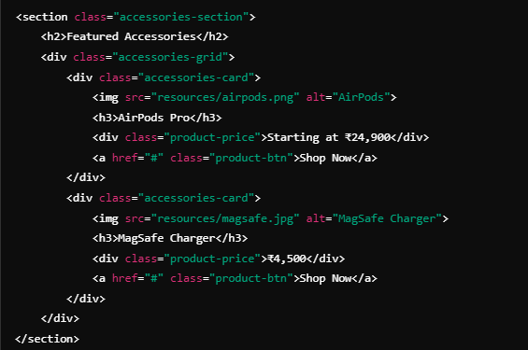
HTML Structure (Accessories Section)
Notes:
"Teacher's Activity"
Project Codebase:
Basic: Apple Clone
Advance: Apple Clone
Objective:
Understand how to create a Accessories section layout using HTML
**** Use Tr code's for recap for better explanation and for code completion use code base. ****
Teacher Instructions:
Display the screenshot of the HTML code.
Provide an overview of the section:
Code Explanation:
This section lists featured accessories, styled similarly to the product section.

Slide 10
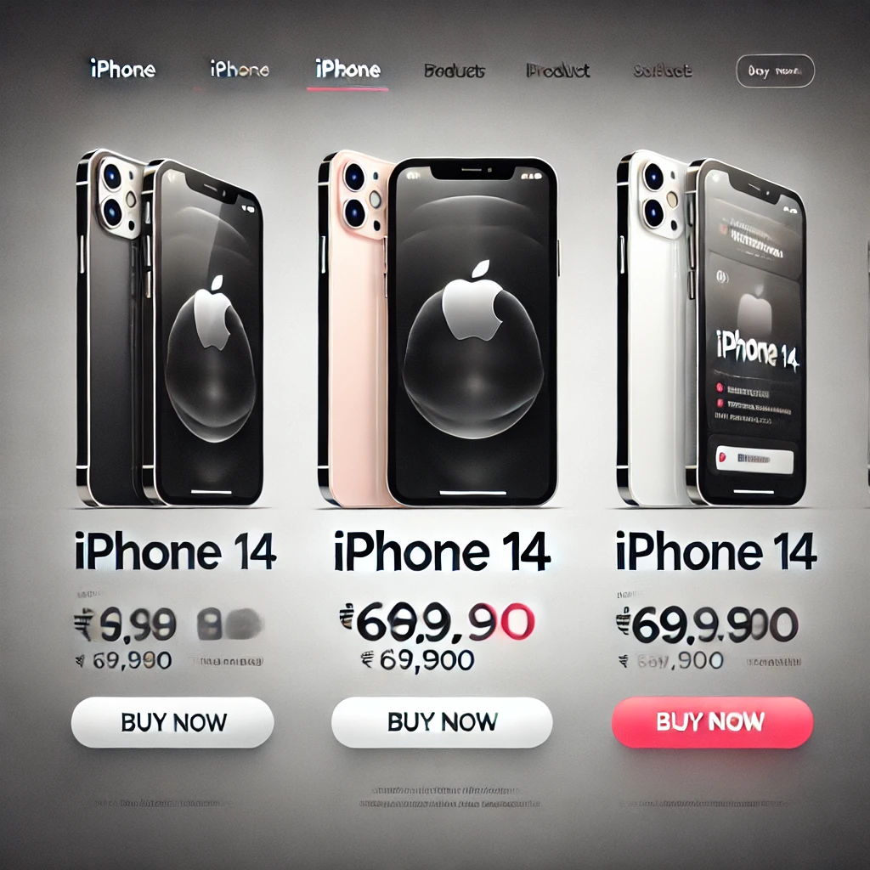
Now it's your turn!
Add a new product to the iPhone section of the Apple website. Include the following details:
Product Name: iPhone 14
Price: ₹69,900
Button Text: Buy Now
Students should add this product next to the existing iPhone models using the same structure.
Notes:
"Students' Activity"
Objective:
The task will help students practice adding new content to the product grid, reinforcing HTML structure and basic CSS styling.
Instructions:
Instruct students to copy the existing product card in the iPhone section and update the details (product name, image, price, and button text).
They should ensure the new product card follows the same style as the other products in the grid.
Review:
After the 5 minutes, have students save and refresh their browsers to ensure the new iPhone 14 is correctly added and aligned with the other products.

Slide 11

Question:
What HTML element is used to display the price of a product in the iPhone section?
A) <span>
B) <h3>
C) <div>
D) <p>
Notes:
Answer: C) <div>

Slide 12
Question:
Which CSS property is used to space out the product cards in a grid layout?
A) margin
B) padding
C) gap
D) border
Notes:
Answer: C) gap

Slide 13
Question:
What Flexbox property ensures the products are aligned in the center?
A) align-items: center
B) flex-direction: row
C) justify-content: center
D) align-content: center
Notes:
Answer: C) justify-content: center

Slide 14
Question:
In the product section, what is the purpose of the product-btn class in CSS?
A) To change the product image
B) To style the "Buy Now" button
C) To change the font size of the product name
D) To align the product price
Notes:
Answer: B) To style the "Buy Now" button

Slide 15
Question:
Which tag is used to add images for the products in the iPhone section?
A) <a>
B) <img>
C) <figure>
D) <button>
Notes:
Answer: B) <img>

Slide 16
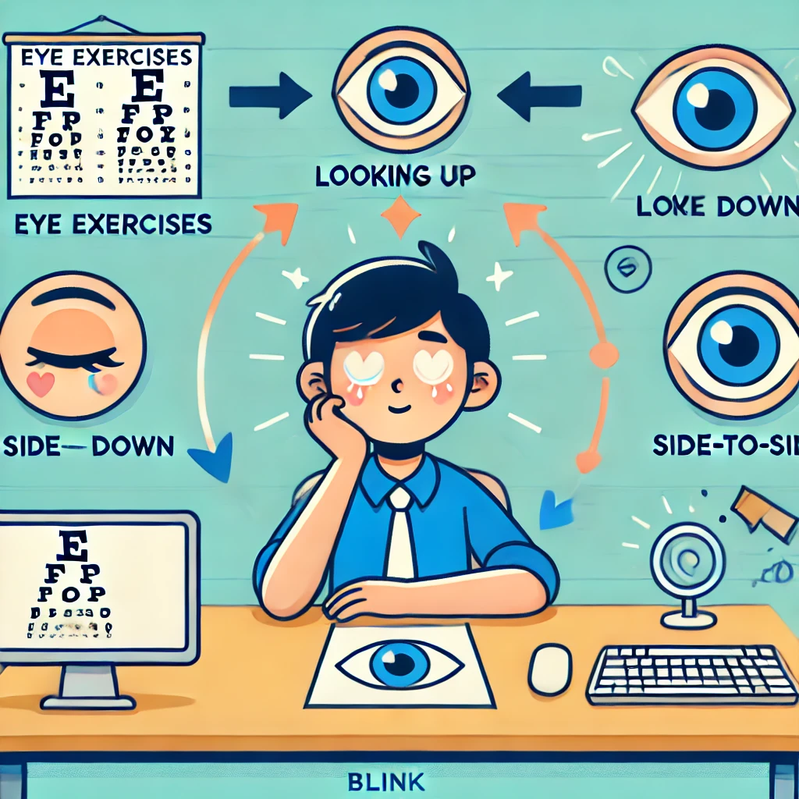
Eye Exercises
Notes:
Teacher Instruction : Explain importance of eye exercises
Why Eye Exercises Matter:
Staring at screens for long periods can strain your eyes.
Taking regular breaks keeps your eyes healthy and relaxed.
Simple Eye Exercises:
Look up and down: Slowly move your eyes up and down 5 times.
Side-to-side: Move your eyes from left to right 5 times.
Blinking: Blink quickly for 10 seconds to refresh your eyes.
Focus shift: Look at something far away for 20 seconds, then something close for 20 seconds.

Slide 17

Product Section: Added and styled iPhone products using HTML and CSS.
Flexbox Grid: Organized product cards into a grid layout with equal spacing.
Button Styling: Styled the "Buy Now" buttons using CSS classes.
Responsive Design: Ensured the product grid remains responsive across devices.
What have we learnt?
Notes:
Objective:
Summarize the key learnings from the lesson.
Teacher Instructions:
Instruct Student's to recap Today's Learning
Keep a healthy discussion engage student to a group discussion
Show a glimpse of what is awaiting to be reveal on the next class

Slide 18
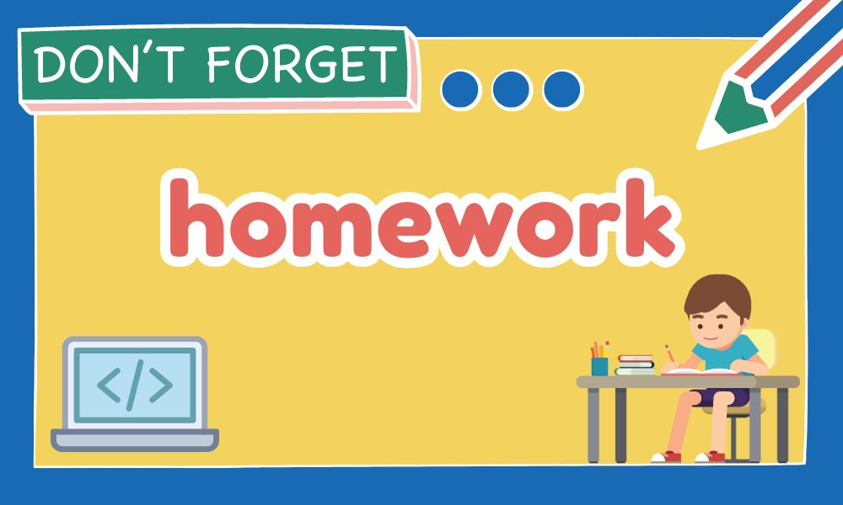
Homework Discussion
Notes:
Instructions for the Teacher: Facilitate a discussion about the homework assignment.

Slide 19

Be careful when sharing personal information online.
Never share your passwords, home address, phone number, or personal details on websites, social media, or with strangers. Always ask a trusted adult if you're unsure about what information is safe to share.

